Slide 1
Integrated Information Platform for Information about Indian Universities
Under guidance of
Mr. BALAMURUGAN R,
AP AUTOMOBILE ENGINEERING,
BIT,
Sathy.
Student 1 (202CB102-ANUSURYA S)
Student 2 (202CB120-LAKSHMI M)
Student 3 (202CB118-KEERTHANA SHRI E)
Student 4 (202CB139-SARUMATHI M)

Slide 2
Abstract
When I completed 12 th , searching for best colleges in India was a big
task. There are more than 1000 universities in India and these
universities are offering a lot of courses. After searching, comparing
those colleges based on various features like fee structure,
infrastructure, hostel facilities was again a hectic work. So it would
be better if a PAN India university information bank is created for
accessing course details, comparison of courses, facilities and faculty,
admission, tracking student mobility, viewing results, evaluation and
certification, verification of certificates, joint online courses
(MOOCs). We’ve have decided to create a website for this. We hope
that this would help both student and faculty communities for self-
improvement through comparison and emulations. Lack of
information is leading to self-glorification and inbreeding among
University and College student and faculty members. This website
will enhance the transparency and remove difficulty being faced by
the students due to lack of information.

Slide 3
Problem Statement Addressed
Finding the best Indian Universities and comparing them based on various criteria like fees structure, hostel facilities, Infrastructure, etc. is a difficult task . The reason for this is students have to search these details in each Universities' website. There are more than 1000 Universities in India. Lack of a Single Platform to view all these details of Universities makes the task difficult for the students.

Slide 4
Existing Solution to the Problem Addressed
There are certain websites like Careers360, shiksha.com which provides all the information about the Universities.
But these websites doesn’t provide accurate information.
Moreover these websites aren’t updated often.
They also lack information about some universities.

Slide 5
Proposed Solution to the Problem Addressed
We’ve planned to solve this problem by creating an integrated website that contains information about all Indian universities. This website also contains special features like chat options, filters, personalized recommendations, add to wish list and a comparison feature. The website also has different themes. Users can choose any one among these.
Thus, this integrated website would reduce the time taken by students for searching and filtering among 1000 universities.

Slide 6
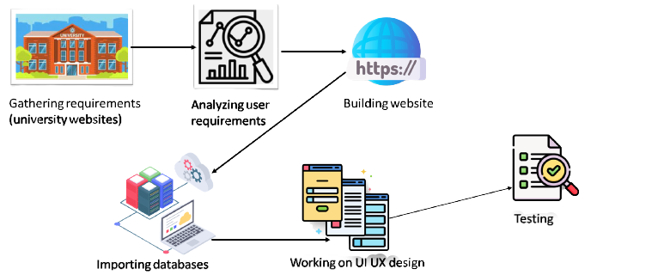
Block Diagram and/or Circuit Diagram

Slide 7
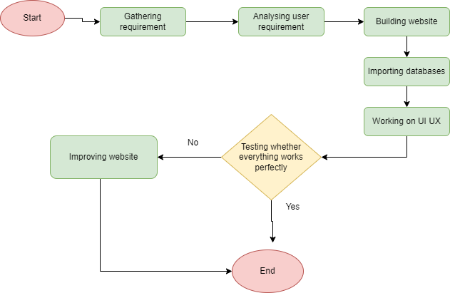
Flow Chart

Slide 8
Effective utilization of the Modern Tool & Cloud
01
03
It acts as a single platform to view and compare Indian Universities for the users’ convenience.
Platform
Solution
Easiness
02
This problem can be solved by creating a portable and user-friendly website with abundant data of Indian Universities.
It reduces the hectic work of searching several websites and saves the time of the users.

Slide 9
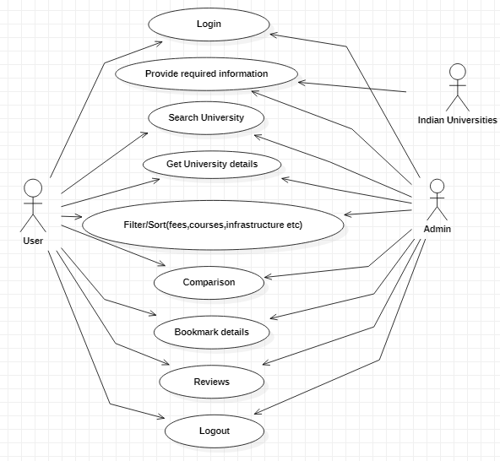
Technology stack & use case
JavaScript
HTML
Django
CSS
React

Slide 10
Prototype & Sample Output
Refer the below link to view the sample of our website
https://anusuryacb20.wixsite.com/easy2find

Slide 11
Analysis of Results & Discussions
Advantages
· Reduces time taken to compare colleges/universities
· Recommendation helps students to easily identify their best choices
. Chat feature makes the website more user friendly

Slide 12
Cost Benefit Analysis (List of Components / Service Used)
Our project belongs to software stream, so we have mentioned the languages used alone.
S.No | Component Name | Specification (IC number or Range or Value) | Unit Cost | Total Cost
1 | Html
2 | CSS
3 | JavaScript
4 | Django
5 | React

Slide 13
References
https://www.dragon360.com/blog/integrated-web-development-seo/
https://in.pcmag.com/web-hosting/70702/how-to-create-a-website

